Slide 1
Data Science from Scratch Chapter 5 – Statistics
B411236 한인수

Slide 2
1. Describing Set of Data
Why Statistics need?
1. larger data set
2. need special case value (ex. Sorted, largest, smallest ..)
Central Tendencies
1. median : Unchanged point (sorted)
2. mean(average) : Changed point
-> effected by outliers (이상점)

Slide 3

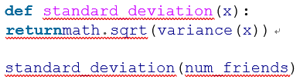
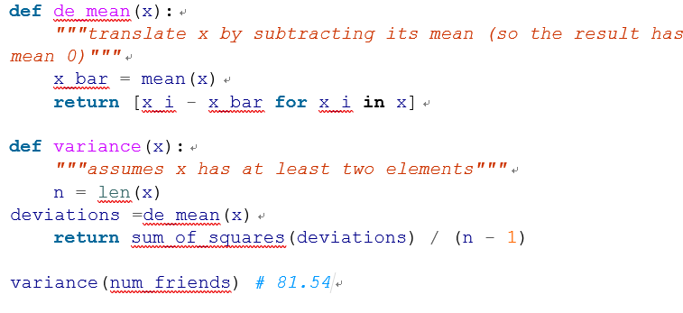
2. Dispersion How spread out data : near zero -> less spread out
Range : difference between largest and smallest (unchanged)
Variance : sum_of_squares(x_i-x_means for x_i in x) / (len(x)-1)
standard deviation : 산포도. Sqrt(variance)

Slide 4
3. Correlation
Covariance : measure how two variables in tandem from means
large positive convariance : 정비례
large negative convariance : 반비례
-> hard to interpret, so we use Correlation
Correlation : unitless and between -1 to 1
sensitive to outliers(특이치)
there may be other sorts of relationships

Slide 5
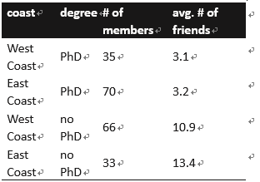
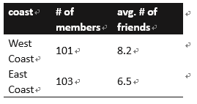
4. Simpson’s Paradox
부분에서 성립한 대소 관계가 전체에서 성립되지 않는 모순
-> need to check possible confounding factors
Ex.

Slide 6
5. Correlation and Causation
correlation is not causation
But, if x and y are strongly correlated, that might mean that x causes y, that y causes x, that each causes the other, that some third factor causes both, or it might mean nothing

